Slide 1
EDA Loan Analysis
by
Tejasvi J (cse-c) & Shruthi T (cse-c)

Slide 2
APPLICATION_DATA
DATASET 1 :

Slide 3
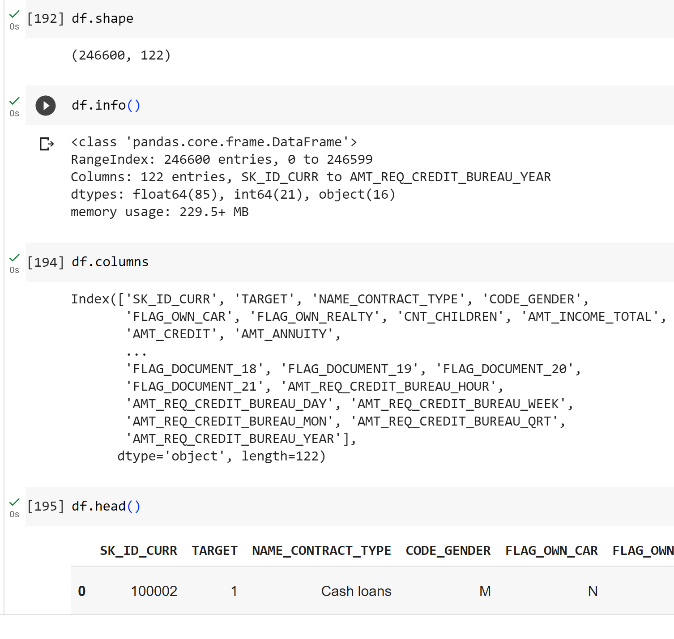
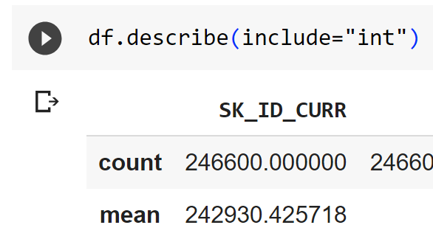
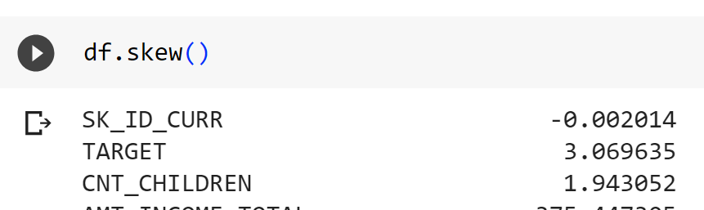
Exploratory Data Analysis
The dataset is initially explored to understand the shape , the info, the values and the columns of the dataset.

Slide 4
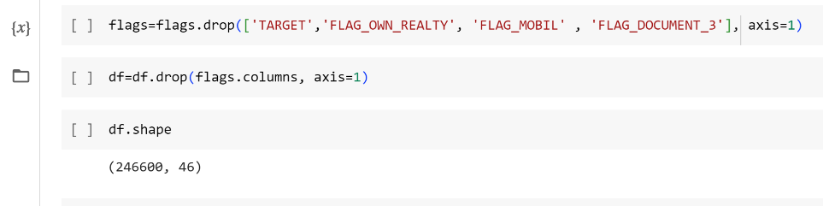
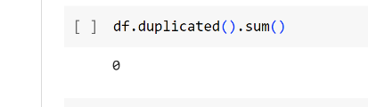
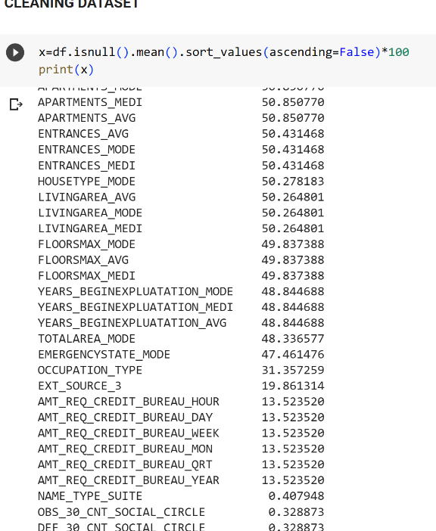
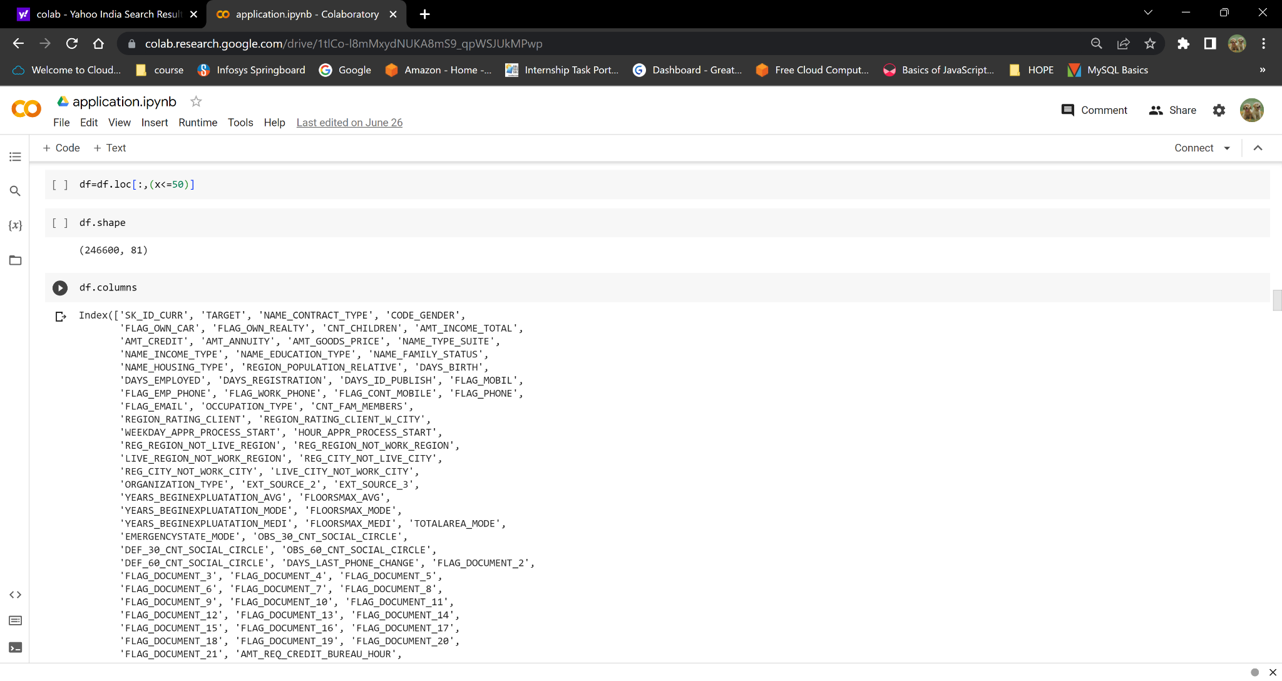
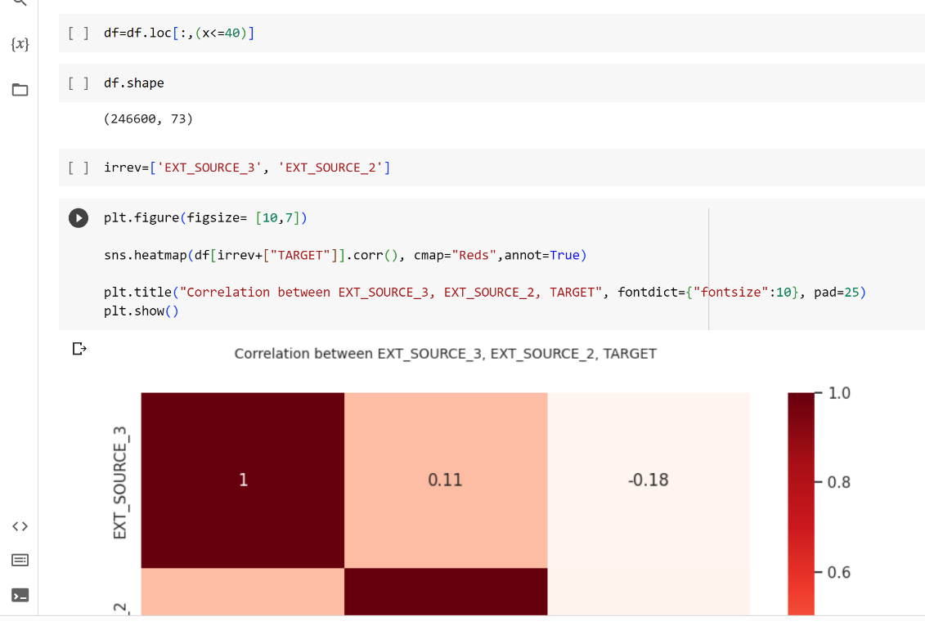
Cleaning the dataset
Finding the null values present in the dataset and cleaning the dataset based on the null values.
The columns which have more than 50% of the null values are removed or replaced with median or mode .

Slide 5
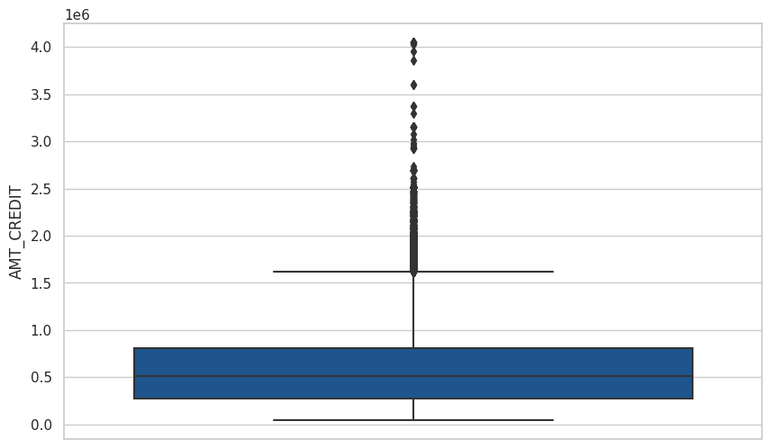
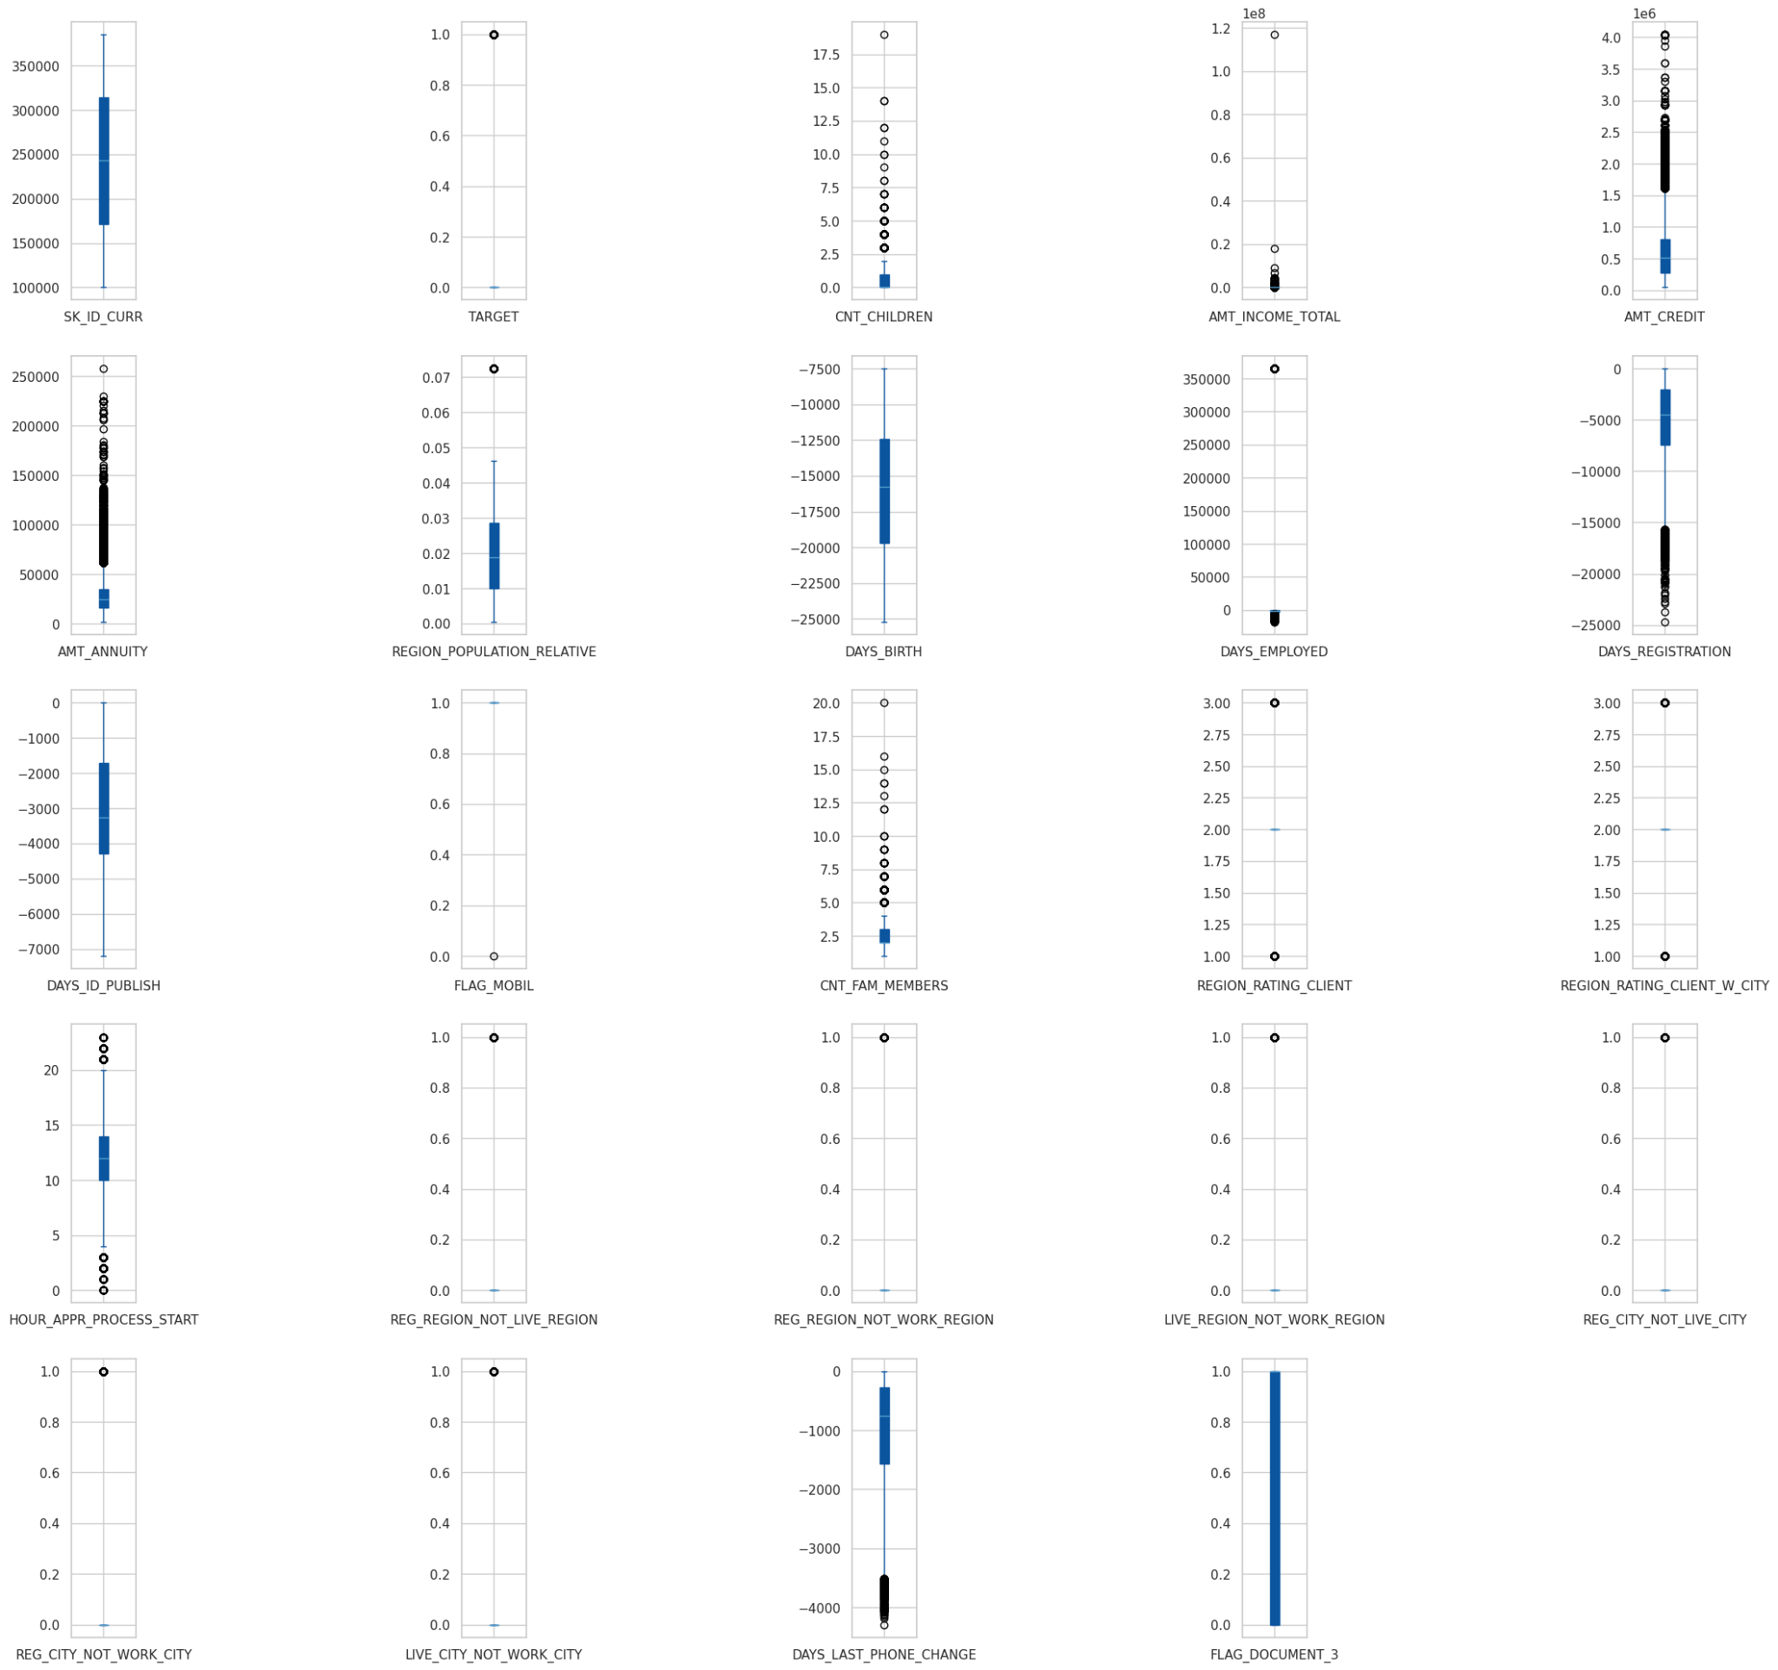
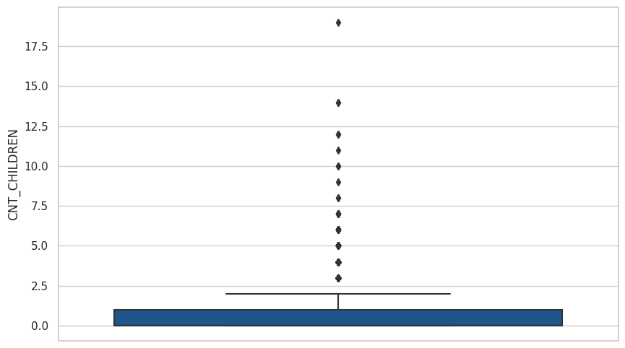
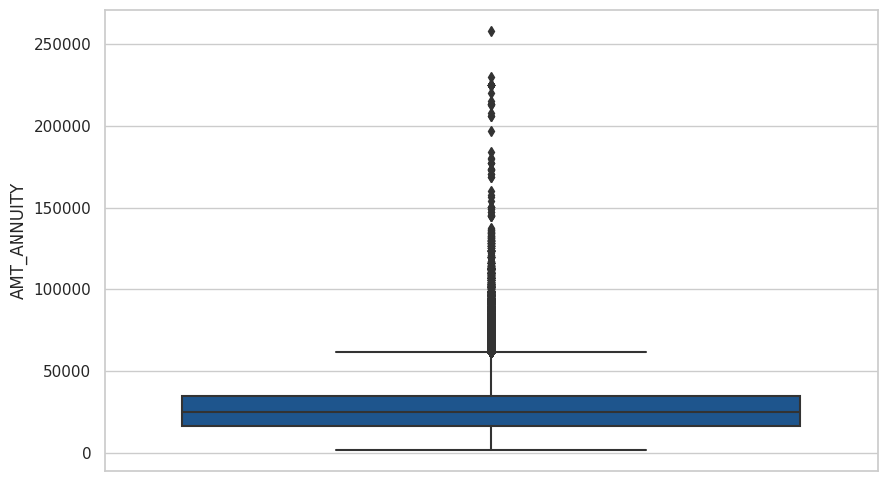
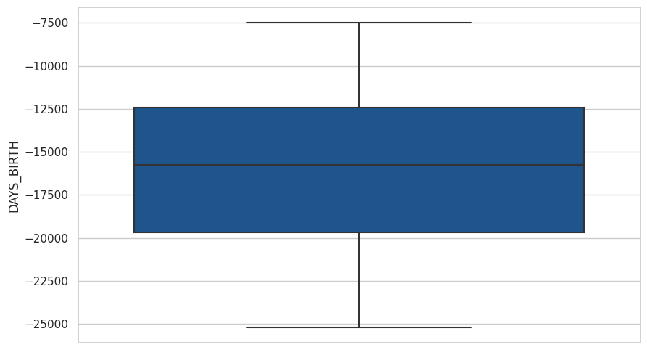
Outliers
Outliers are found to check the distribution of the data over the dataset.
They are eliminated or balanced to avoid unbiased training of the data

Slide 6
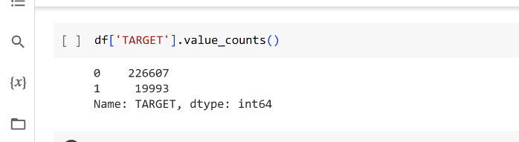
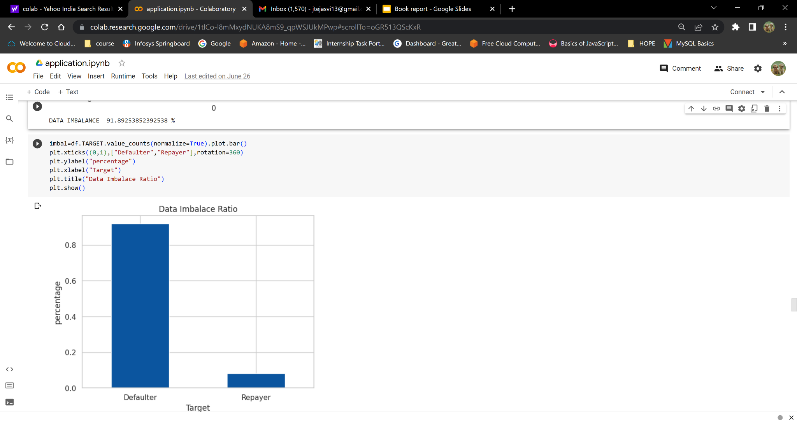
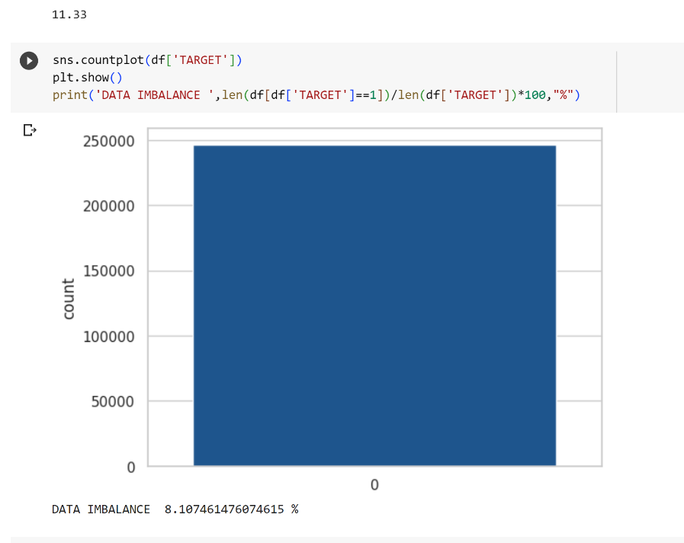
Data Imbalance
The dataset contains 300000 of data in which only 20% of data is of target 0 and remaining 80% of the data is of target 1.
This shows the clear imbalance of data in the dataset .

Slide 7
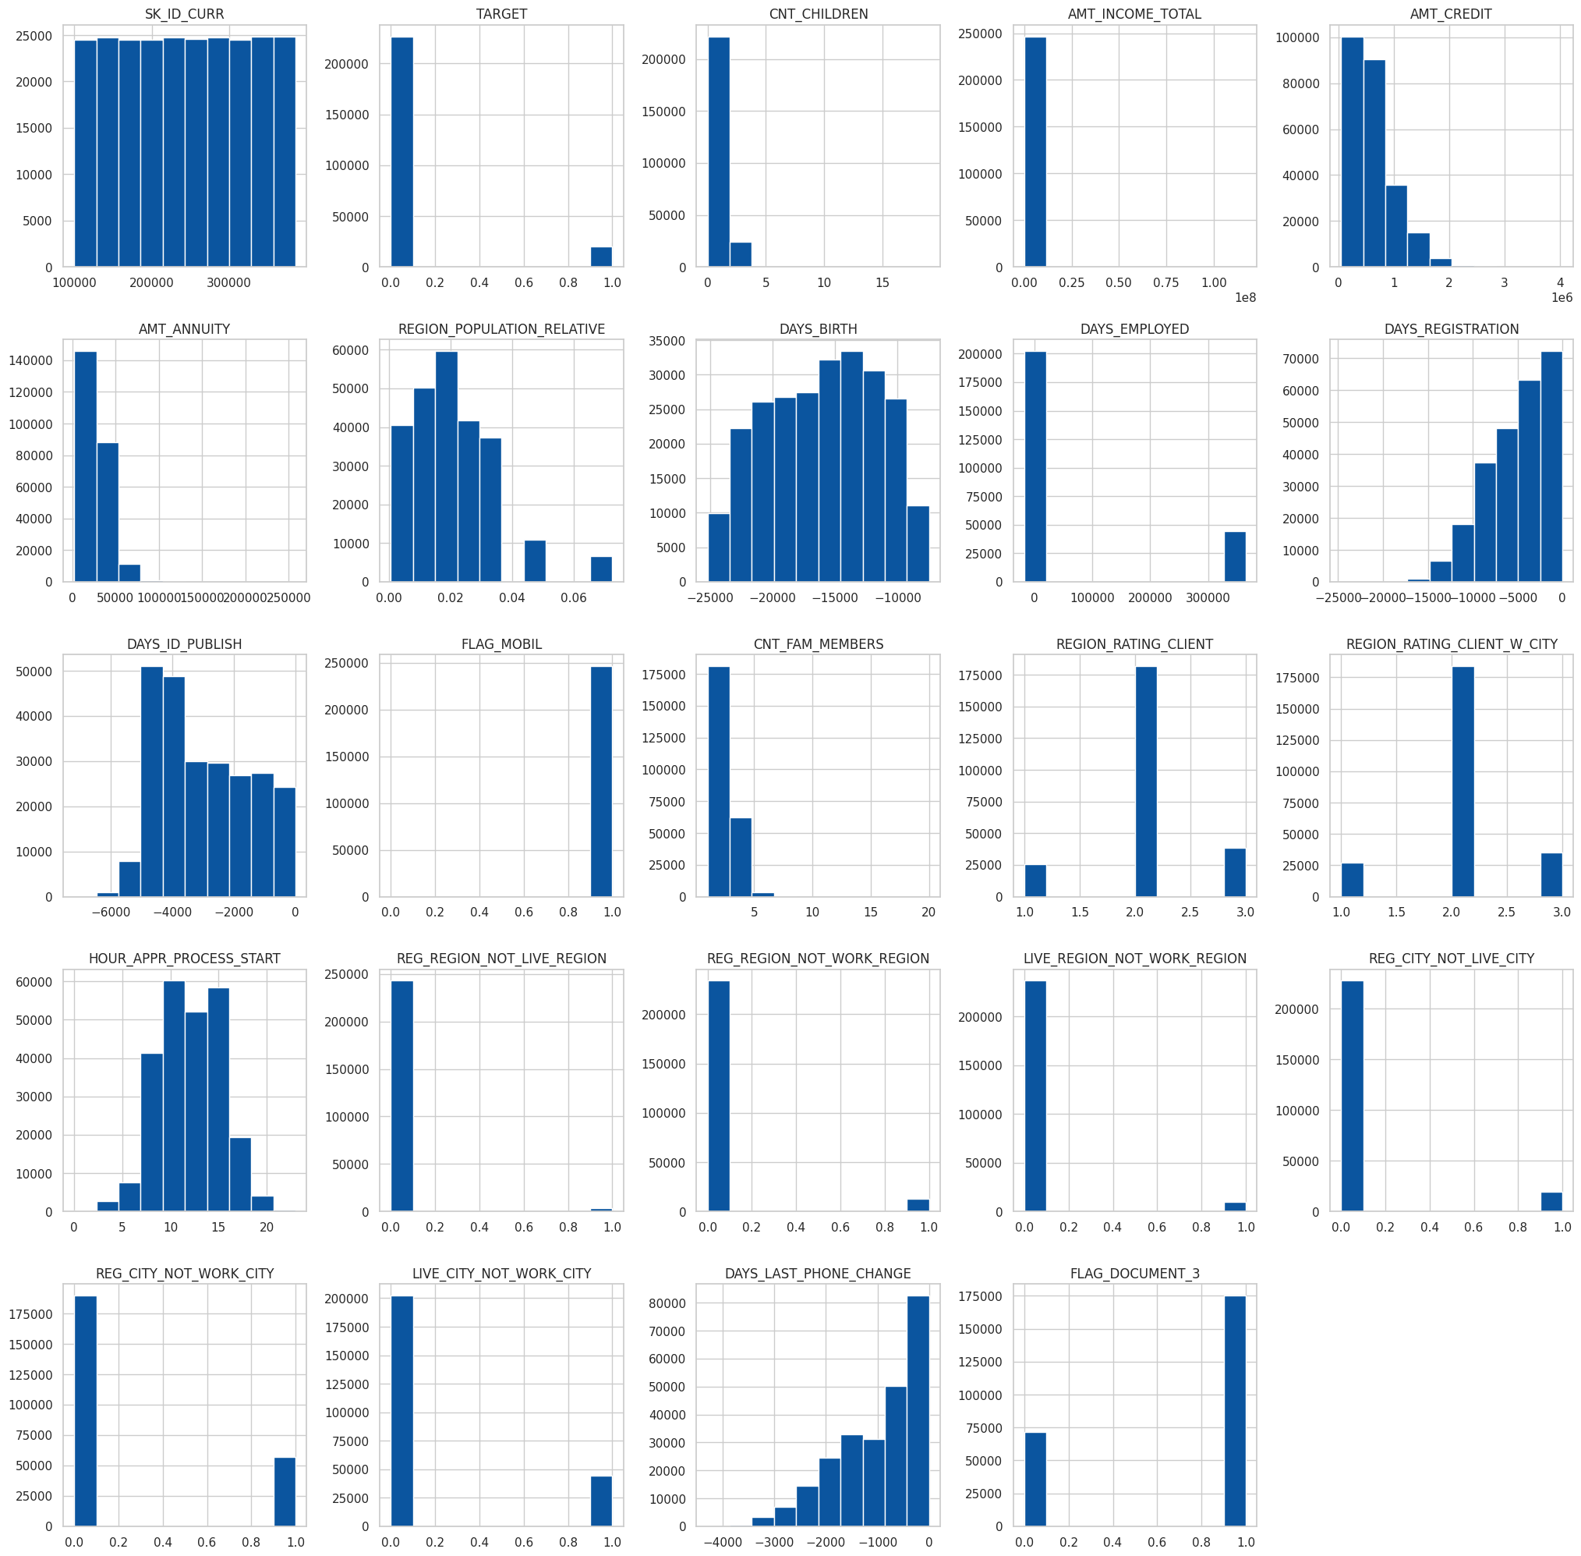
Univariate Analysis
Analysis of all the columns in the dataset with respect to them.
Each plot represents each columns analysis.
These plots show the distribution and pattern of the columns in the entire dataset .

Slide 8
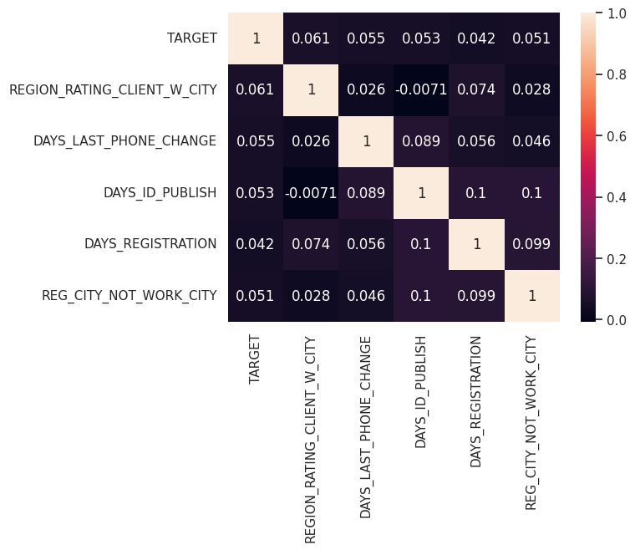
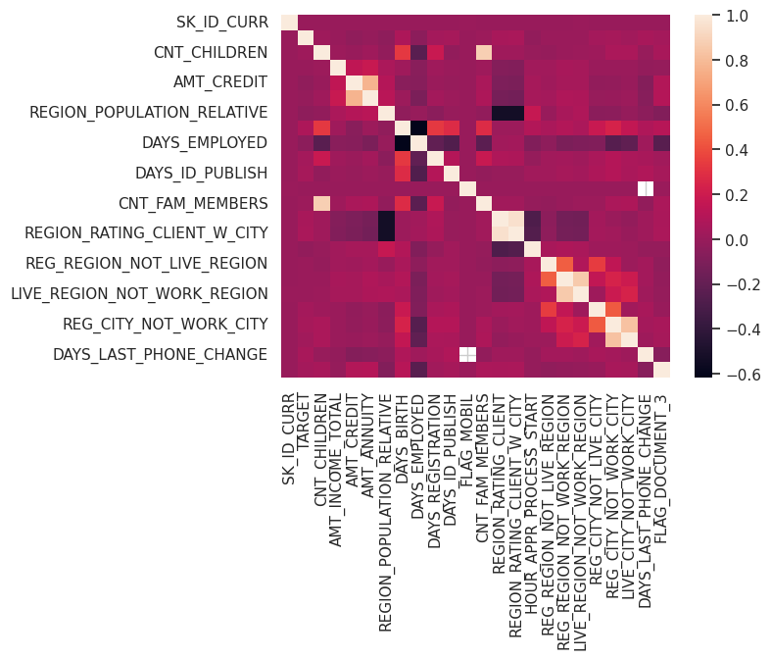
Correlation of Variables
The variables are mapped to each other to find the correlation between them. The positively correlation shows that the variables are dependent on each other.

Slide 9
PREVIOUS_APPLICATIONDATA
DATASET 2 :

Slide 10
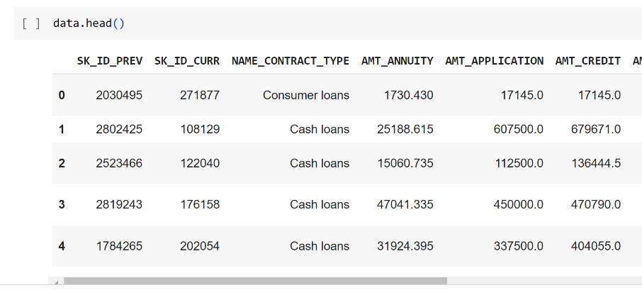
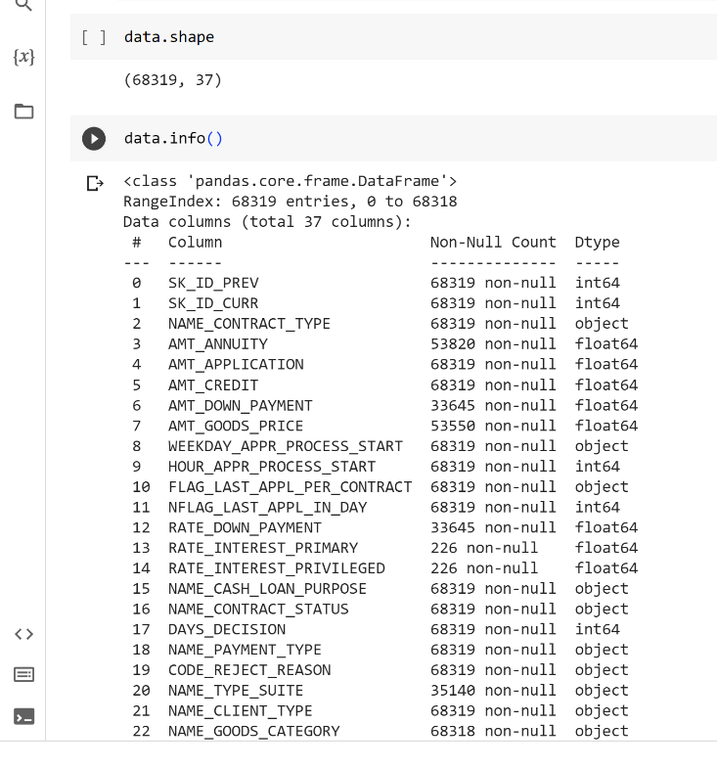
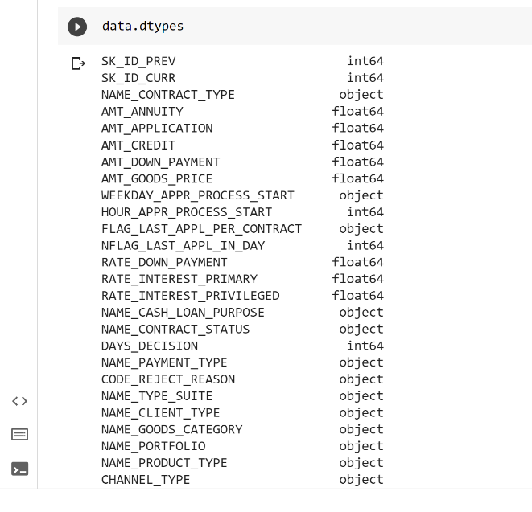
Exploratory Data Analysis
The dataset is initially explored to understand the shape , the info, the values and the columns of the dataset.

Slide 11
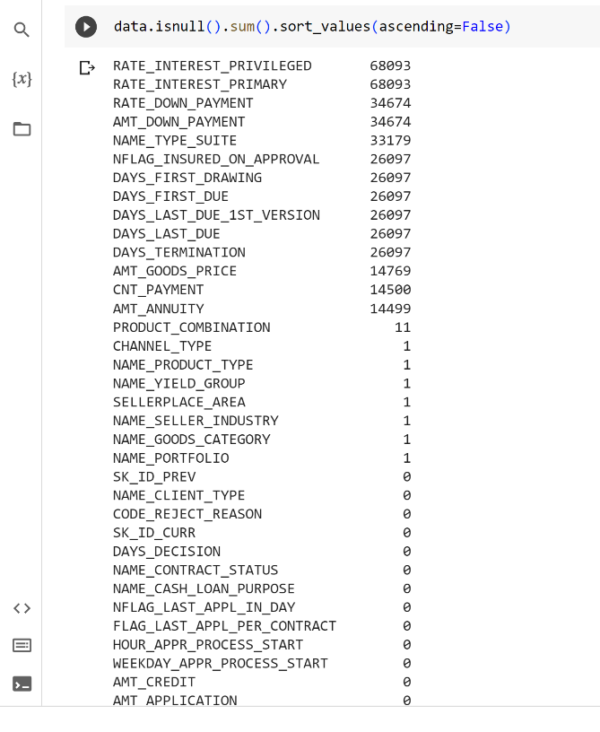
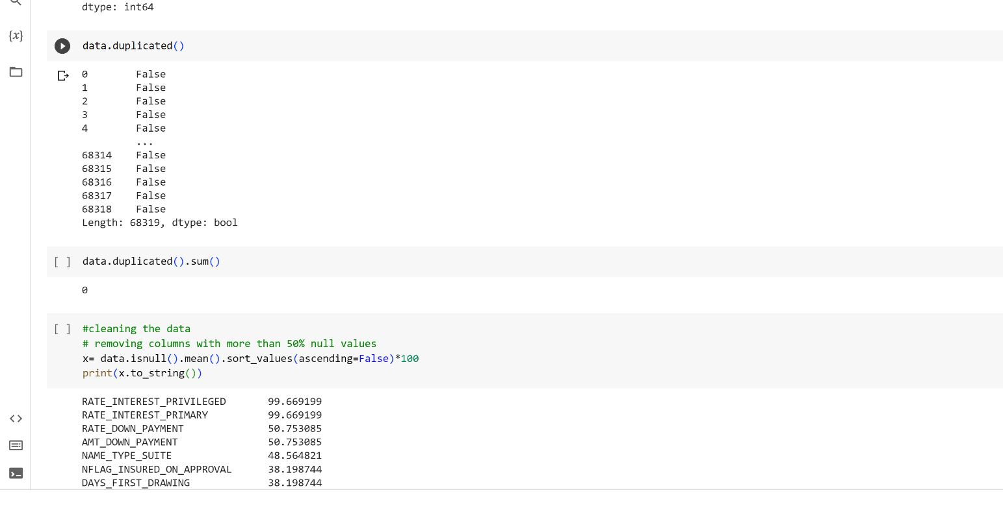
Cleaning the dataset
Finding the null values present in the dataset and cleaning the dataset based on the null values.
The columns which have more than 50% of the null values are removed or replaced with median or mode .

Slide 12
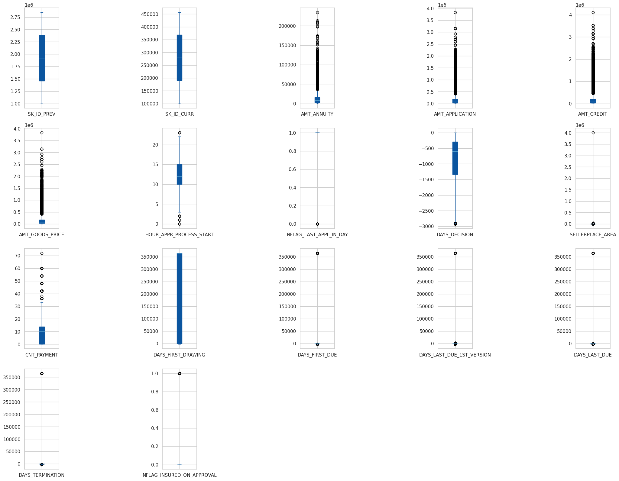
Outliers
Outliers are found to check the distribution of the data over the dataset.
They are eliminated or balanced to avoid unbiased training of the data

Slide 13
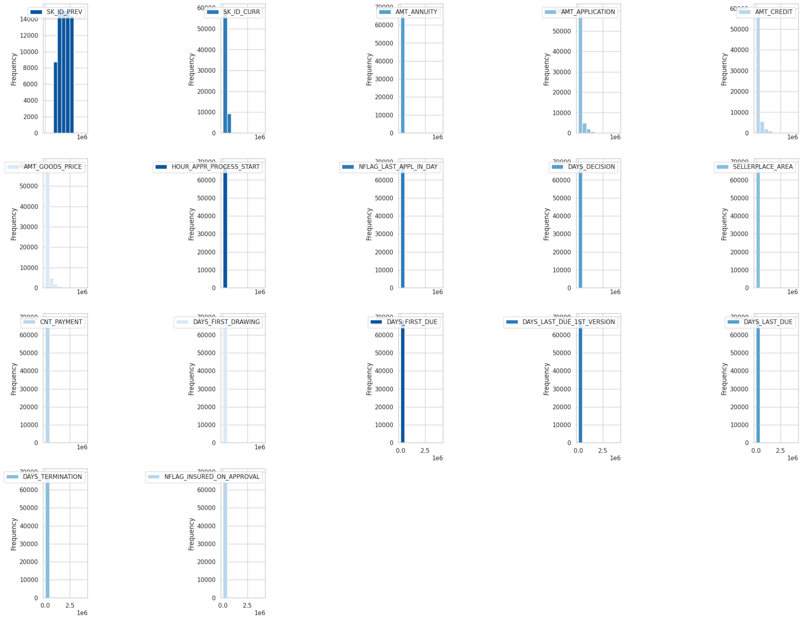
Analysis
Analysis of all the columns in the dataset with respect to them.
Each plot represents each columns analysis.
These plots show the distribution and pattern of the columns in the entire dataset .

Slide 14
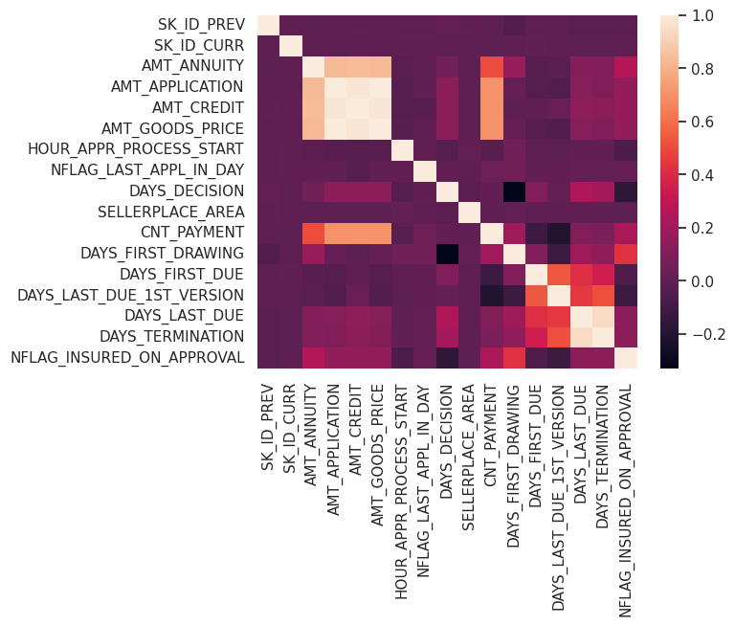
Correlation of Variables
The variables are mapped to each other to find the correlation between them. The positively correlation shows that the variables are dependent on each other.

Slide 15
Conclusion
The datasets have been carefully studied and have been explored based upon our understanding of the datasets.
The exploration and analysis of the dataset have been done by both of us to the maximum of what we were able to do .
Thus the Application dataset and the previous application dataset have been explored and analysed

Slide 16
THANK YOU

